Slide 1
steps to detect gene fusion at DGD

Slide 2
CHOP Comprehensive Solid Tumor Panel
Solid Tumor Panel (DNA based)
237 solid tumor related cancer genes
NGS capture-based technology
Home-brew bioinformatics pipeline
Copy number analysis using NextGENe software
Fusion Panel (RNA based)
106 major fusion partners associated with 586 known cancer fusions
Archer technology
Acceptable specimens:
Fresh, frozen, or paraffin embedded tumor
Request at least 30% tumor cellularity
Slide from Lea Surrey @ DGD

Slide 3
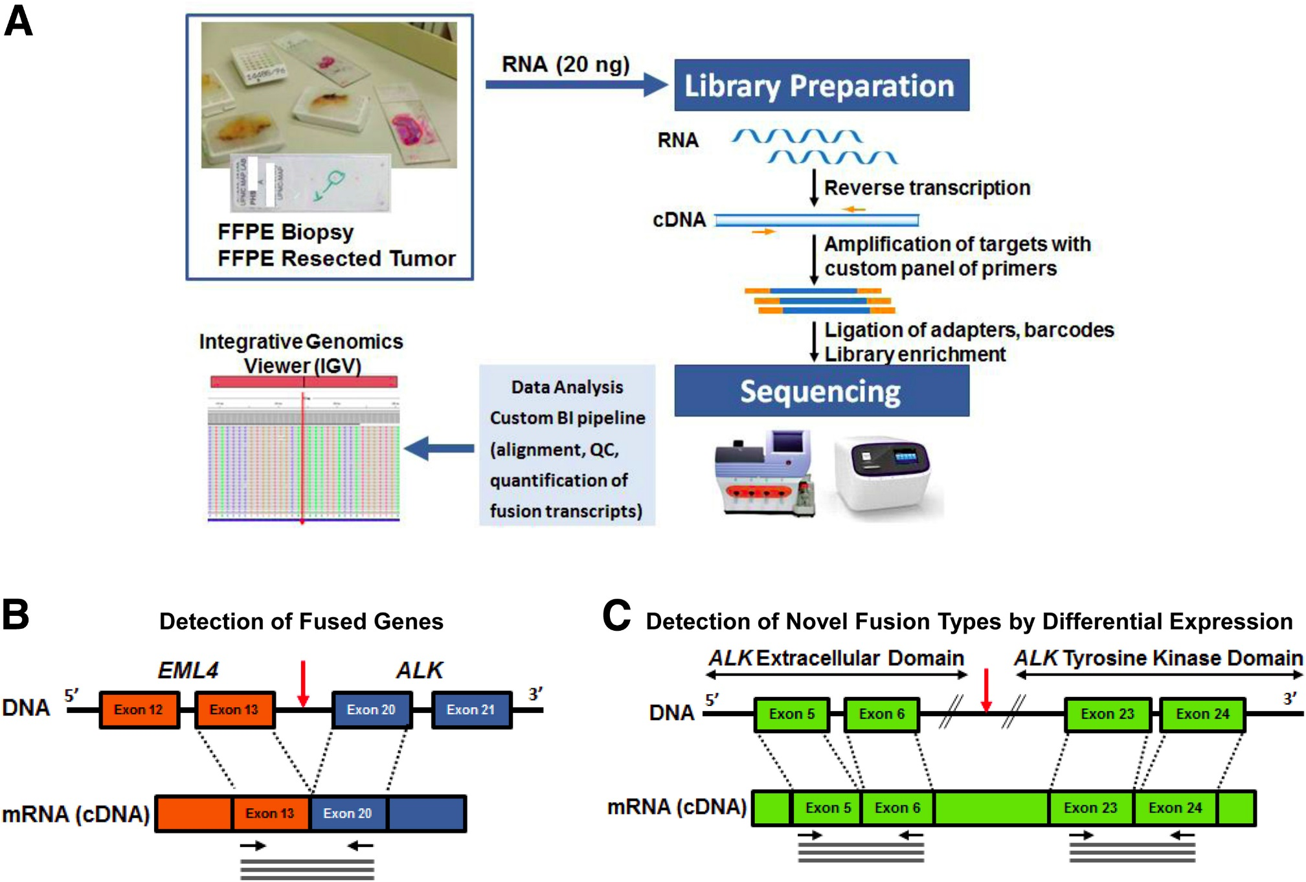
Figure 1
The Journal of Molecular Diagnostics 2016 18, 165-175DOI: (10.1016/j.jmoldx.2015.10.002)
Notes:
Fusion gene assay workflow. A: RNA is extracted from formalin-fixed, paraffin-embedded (FFPE) tumor specimens and reverse transcribed into cDNA. The cDNA is subsequently amplified with a multiplex of primers targeting fusion transcripts and native control transcripts. Libraries are sequenced on Ion Torrent instruments, and the sequence reads are enumerated using a custom pipeline. Identified fusion transcripts are confirmed by inspection of aligned reads in the Integrative Genomics Viewer (IGV). B: Fused genes are detected by PCR amplicons that span the fusion breakpoint. C: Novel fusions may also be detected by an elevated read count in the 3′ region versus the 5′ region of a transcript, for example, by differential expression of the exons of the RET transcript encoding the kinase domain versus the extracellular domain.

Slide 4

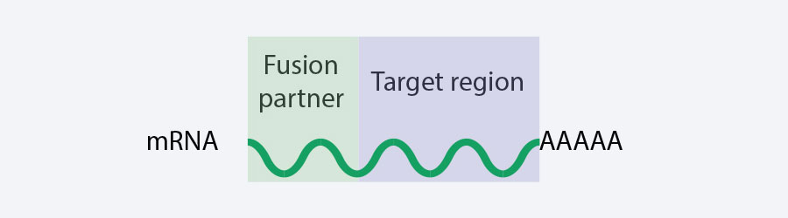
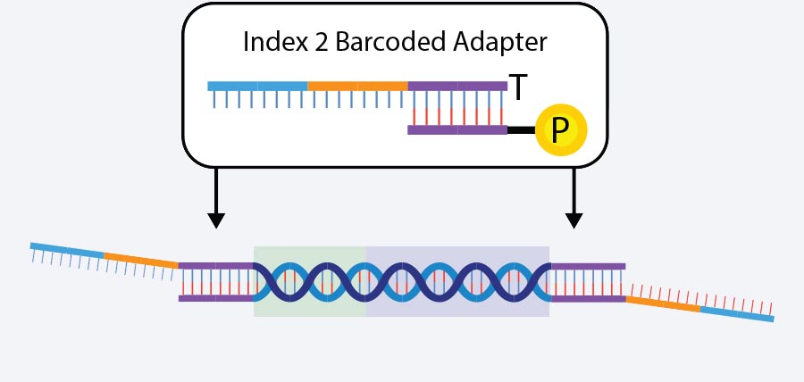
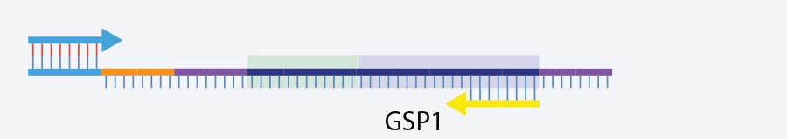
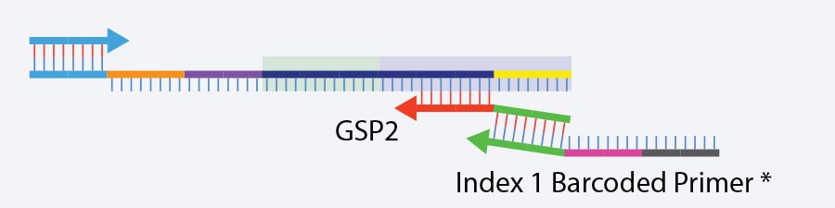

Anchored Multiplex PCR
Unknown Partner
Target
cDNA
Attach Adapter
Target-specific PCR 1
Target-specific PCR 2
Sequencing Ready Library

Slide 5
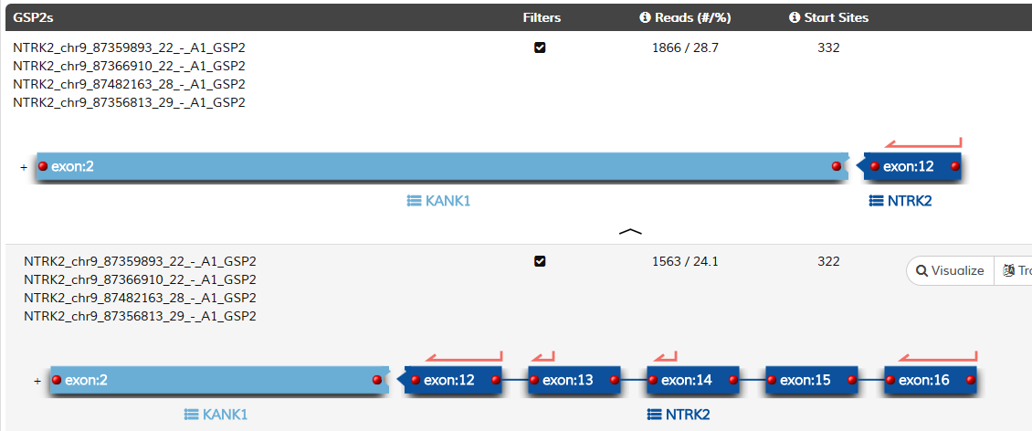

Slide 6
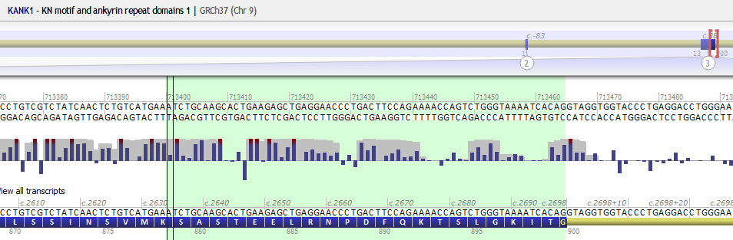
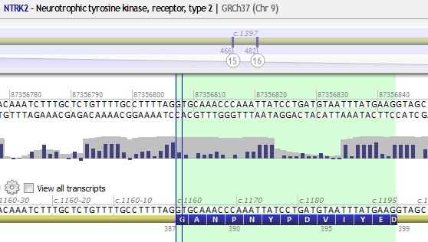
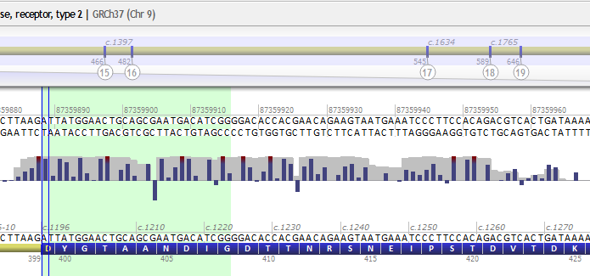
ATCTGCAAGCACTGAAGAGCTGAGGAACCCTGACTTCCAGAAAACCAGTCTGGGTAAAATCACAGGTGCAAACCCAAATTATCCTGATGTAATTTATGAAGATTATGGAACTGCAGCGAATGACATCGG
KANK1 (NM_015158.4) exon 3; NTRK2 (NM_006180.4) exon 12 (in frame, kinase domain intact); NTRK2 (NM_006180.4) exon 13
KANK1 Exon 3
NTRK2 Exon 12 and Exon 13

Slide 7
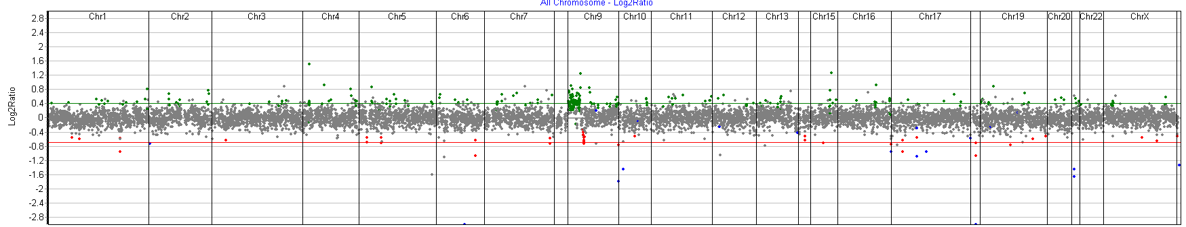
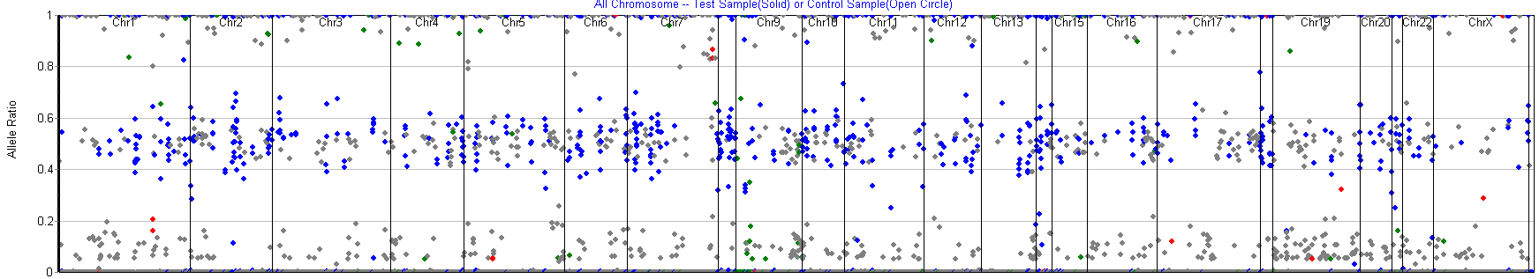
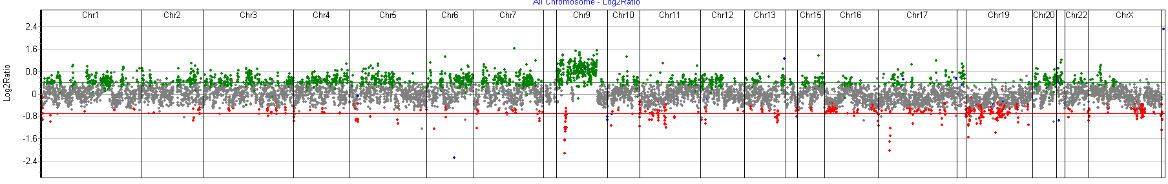
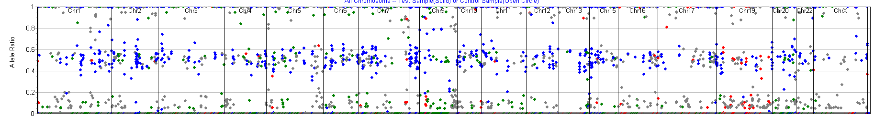
Classic Low-grade Pilocytic Astrocytoma component
Higher Grade Anaplastic Component

